Slide 1
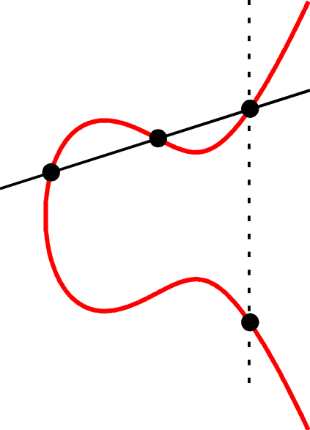
An Introduction to Pairing Based Cryptography
Dustin Moody
October 31, 2008

Slide 2
BOO!

Slide 3

Definitions
Let G₁ and G₂ be abelian groups, written additively.
Let n be a prime number such that [n]P for all P in G₁ and G₂ .
Let G₃ be a cyclic group of order n, written multiplicatively.
Then a pairing is a map:
(Bilinearity)
(Non-Degeneracy)

Slide 4


Properties of Bilinear Pairings

Slide 5
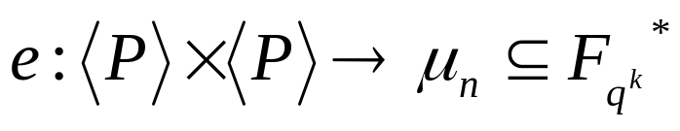
Pairings on Elliptic Curves
For our purposes, we will use the following:
Let E be an elliptic curve defined over F_{q.}
Let P be a fixed point on E of prime order n.
Let k be the order of q mod n.
Then k is also the smallest integer such that n | (q ^{k} - 1).
k is called the embedding degree.
Pairings will be of the form
We’ll also require that e(P,P) ≠ 1, which can be done using distortion maps.

Slide 6
Computability and the Embedding Degree
The Weil pairing and Tate pairing are examples of pairings on curves.
Both are efficiently computable, provided that the embedding degree k is small.
For a random elliptic curve, k ≈ n, which is too large.
Theorem: If E is a supersingular elliptic curve, then k ≤ 6.
(Recall E is supersingular if #E(F_{pr}) ≡ 1 mod p.)
There are ordinary curves with low embedding degree
(MNT curves have k = 2,3, or 4.)

Slide 7
Cryptographic Applications
MOV attack- Transfers the discrete logarithm problem on E to a discrete logarithm in F_{qk}.
Separating DDH from DH- Pairings can be used to show the Decision Diffie-Hellman problem is easier than the Diffie- Hellman problem on some curves.
Identity based encryption- Public key encryption system where the users public key is based on his own identity, i.e. an email address.
Short signatures- Signature schemes with signatures half the length of other signature schemes.
Key exchange- A tripartite key exchange can be done in one round.
Group structure of E- can be determined efficiently using pairings.
Identity based signatures, Identity based key exchange……..

Slide 8
The MOV attack
1993 (Menezes, Okamoto, and Vanstone)
Discrete Log (DL) Problem: Given P and Q = [c]P on E, find c.
The attack:
1) Find S of order n on E, such that e(P,S)≠1.
2) Compute e(P,S) = ζ.
3) Compute e(Q,S) = e([c]P,S) = e(P,S)^{c} = ζ^{c}.
4) Solve the DL in F_{qk} with ζ and ζ^{c}.
Best algorithms for solving DL on elliptic curves is O(√ n ).
In F_{qk}, there are subexponential methods (index calculus).
Note, the attack is only efficient for small k.

Slide 9
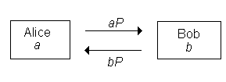
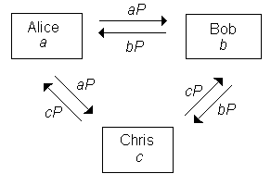
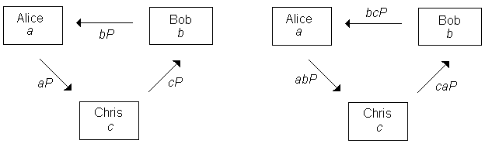
Key Exchanges
Diffie-Hellman Key exchange:
1) Alice selects secret a, sends [a]P to Bob.
2) Bob selects secret b, sends [b]P to Alice.
3) Each can compute the key [ab]P
Extend to three parties?

Slide 10
One Round Tripartite Key Exchange
2000 (Joux)
Alice sends [a]P to Bob and Chris
Bob sends [b]P to Alice and Chris
Chris sends [c]P to Alice and Bob
All can compute the key e(P,P)^{abc}.
(For example, Alice computes e([b]P,[c]P)ª.)

Slide 11
Security
For the Diffie-Hellman key exchange, security is based on the (DH) problem:
Given P, [a]P, and [b]P, compute [ab]P.
For Joux’s tripartite exchange, security is based on the Bilinear Diffie-Hellman (BDH) problem:
Given P, [a]P, [b]P, and [c]P, compute e(P,P)^{abc}.
Clearly, if one can solve the discrete log problem, then one can solve the Diffie-Hellman problem.
Anyone who can solve the Diffie-Hellman problem can solve the bilinear Diffie-Hellman problem.

Slide 12
Separating DH and DDH
The decision Diffie-Hellman (DDH) problem is:
Given P, [a]P, b[P], and Q, determine if Q = [ab]P.
The DDH problem is no harder than the DH problem.
For awhile, there were no examples of groups where the DDH was strictly easier than the DH. Such groups are called “gap Diffie-Hellman groups”.
Pairings make the DDH problem “easy”:
1) Compute e(P,Q)
2) Compute e([a]P,[b]P)=e(P,P)^{ab}
3) Q=[ab]P if and only if the above two results agree.
Thus, elliptic curves with small k are gap Diffie-Hellman groups.
(Actually, the curve needs a distortion map so that e(P,P) ≠ 1.)

Slide 13

Short Signatures
2001 (Boneh, Lynn, and Schacham)
Parameters: E,e,P, and a hash function
Setup: Private key is a secret integer r.
Public key is R = [r]P.
To sign a message M, Alice computes S =[r]H₁(M).
To verify the signature, check if e(P, S) = e(R,H₁(M)).
e(P, S) = e(P, [r]H₁(M)) = e([r]P,H₁(M)) = e(R,H₁(M)).
To forge a signature on M, need to be able to find S = [r]H₁(M), given P,R, and H₁(M), which is a Diffie-Hellman problem in < P >.

Slide 14
Identity Based Encryption
Using public key encryption, when Bob wants to send a message to Alice, he encrypts using Alice’s public key K_{A}.
Suppose the malicious Mallory substitutes her own public key K_{M} for Alice’s. How does Bob know the key isn’t really Alice’s?
One solution is to require a trusted authority (TA) to give certificates for public keys. Such a certificate has Alice’s ID and public key on it, signed by the TA. Bob can check the trusted authority’s signature on the certificate, and be assured of what Alice’s public key is.
1984- Shamir proposed using Alice’s ID information as her public key. (Such a key could be an email address, for example.)
Bob then knows for sure who he is sending his message to.

Slide 15
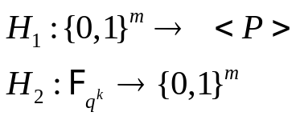

Identity Based Encryption
2001 (Boneh and Franklin)
Parameters: E, P, e, and two hash functions:
Setup: Alice’s public key is K_{A} = H₁(ID_{A}).
The TA has private key s, and public key S=[s]P.
TA gives Alice her secret decryption key D_{A} = [s]K_{A}.
Encryption: To send M, Bob selects a random r and computes
R = [r]P and c = M H₂(e(K_{A}, S)^{r}). He sends Alice (R, c).
Decryption: Alice uses her private key D_{A} to calculate
c H₂(e(D_{A},R)) = c H₂(e([s]K_{A}, [r]P)) = c H₂(e(K_{A}, S)^{r}) = M.
Anyone other than Alice wishing to decrypt the message from (R, c) needs to be able to compute e(K_{A}, S)^{r} = e(K_{A}, P)^{rs} given P, K_{A}, S, and R. This requires solving the bilinear Diffie-Hellman problem.

Slide 16
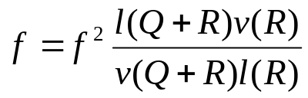
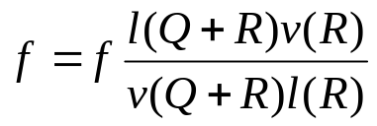
Computing Pairings
Miller’s algorithm to evaluate < P,Q >_{n}
1. Given P,Q with order n, choose R with order n and R ≠ ∞,P,−Q,P−Q.
2. Write n in binary as n = (n_{t}, ..., n₁, n₀).
3. Set f = 1, T = P and i = t.
4. If i < 0 then go to step 5. Else do the following:
(a) Let l be the tangent line to E through T. Let v be the vertical line through 2T.
(b) Set T = 2T.
(c) Set
(d) If n_{i} = 1 then do the following:
i. Let l be the line through T and P, and v the vertical line through T + P.
ii. Set T = T + P.
iii. Set
(e) Set i = i − 1 and return to step 4
5. The desired value is < P,Q >_{n} = f.

Slide 17


Verheul’s Theorem
2001 (Verheul)
XTR: Let p be a prime p ≡ 2 mod 3 and n a prime number such that n | p²+p+1. Let g be a generator of μ_{n}, the group of nth roots of unity in . Let P be a point of order n on a supersingular E defined over with #E( ) = p²+p+1.
Theorem: If an efficiently computable homomorphism can be found from μ_{n} to <P>, then the Diffie-Hellman problem can be efficiently solved in both μ_{n} and <P>.
What are the implications?
My dissertation generalizes Verheul’s theorem.

Slide 18
Conclusion
Active area of research (see Barreto’s Pairing Based Crypto Lounge or eprint.iacr.org)
Many interesting/simpler protocols
Not quite yet in SAGE
Already commercially available -- Voltage
Security needs to be studied and tested
Other pairings (Ate, Eta, Eil, etc…)
Pairings for hyperelliptic curves, abelian varieties
etc….
Questions?

Slide 19
Thank You!

